Slide 1
Antiquities Act
Clifford T. Brown

Slide 2
Antiquities Act of 1906 16USC431-433
“An Act for the Preservation of American Antiquities”
June 8, 1906
Protects ruins and monuments on federal lands from unauthorized excavation or destruction
Fines and incarceration for violations
Provides for permitting for excavations
Requires permanent curation of the artifacts
Authorizes President to declare National Monuments (without Congressional approval)
This is controversial, but has survived both constitutional challenges and Congressional attempts at amendment
Regulations: 43CFR Subtitle A Part 3

Slide 3
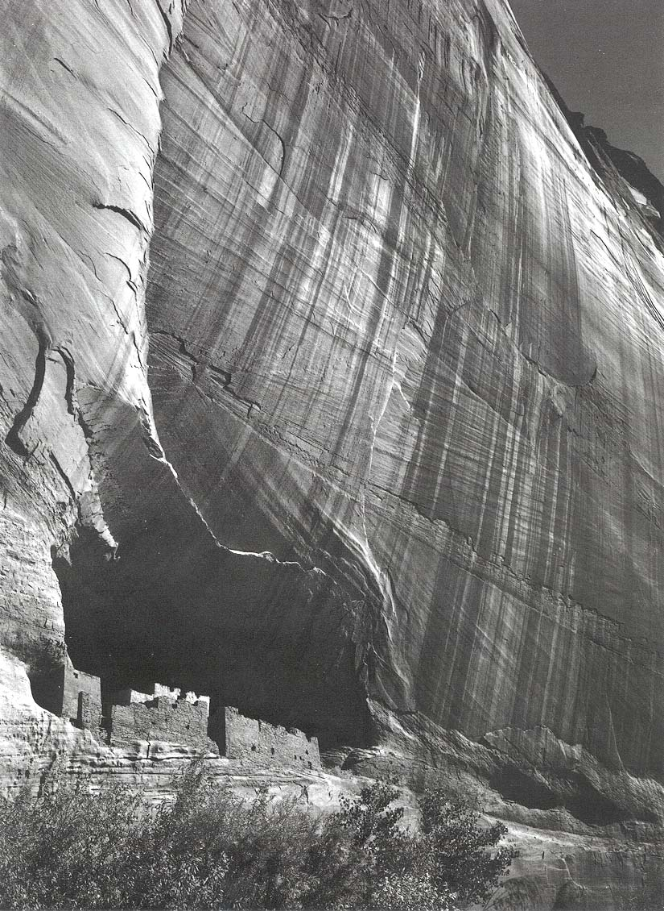
White House Ruin, Canyon de Chelly National Monument, Ansel Adams photo

