Slide 1
CoS New faculty and GTA teaching workshop
October 24, 2022
2-4pm

Slide 2
Table of Contents
General Instructional Policies
Instructional Technology
Class Management and Active Learning
Student Learning Assessment

Slide 3
General Instructional Policies

Slide 4
General Instructional policies
Course Override, Late Registration, and Other Course Registration Issues
Courses to Take for Students
Course Syllabi
Textbook Adoption
Academic Integrity
Students with Disabilities
Other Policies
Please refer to
Florida Atlantic University Academic Affairs Faculty Handbook
https://www.fau.edu/provost/resources/policy-memoranda/, Instructional Memoranda and Policies

Slide 5
Course override, late registration, and other course registration issues
Communicate with the department chair to see how each department handles the request.
Usually the instructor approves such requests and then communicate with department chair/program director and secretary to get the issue resolved.
If the instructor needs to change the students’ status, log onto https://myfau.fau.edu/signed_in/selector/index, go to FAU Self-Service, then Faculty Services, and choose the correct tab to manage students.
When processing override and registration please be mindful of classroom capacity for in-person or hybrid classes.

Slide 6
Courses to take for students
Students need to talk to the advisors to determine the sequence of courses to take
Graduate students need to follow the Plan of Study, which is determined by the student and the academic advisor/program director.
College of Science Advising Services: http://science.fau.edu/student_services/index.php
Students can schedule an appointment with an academic advisor: http://science.fau.edu/student_services/advising.php
Pre-Health Advising: http://science.fau.edu/student_services/pre_health/index.php

Slide 7
Course syllabi
Please follow the FAU template to include all the required items. Other items are optional.
The college has a set deadline of syllabus submission and each department sets up its own deadline when the syllabus needs to be submitted to the secretary.
The syllabus needs to be uploaded to Canvas prior to the start of the semester, under the “Syllabus” section.
The start of the semester at FAU is usually on Saturdays; therefore, the syllabus should be posted on Canvas a few days before that Saturday.
For the most recent syllabus template, please visit: https://www.fau.edu/provost/resources/policy-memoranda/

Slide 8
Textbook adoption
Textbook adoption is done through Canvas. Go to “Follett Discover” under the list of menus for the course (e.g. Home, Annoucement, Modules, Syllabus, etc. “Follett Discover” is nearly all the way down below “Lockdown Browser”).
Follow the deadline to adopt the textbooks. Usually an email will be sent to remind to adopt the textbooks. Do it when seeing the email.
Be mindful of the cost of textbooks.
Specific policies about adopting self-authored book as textbooks (approval and royalty donation).
Even if you don’t have required textbooks the information needs to be entered into Follett indicating no materials will be adopted.
Annual Textbook Adoption Deadlines
Fall - April 15
Spring - October 15
Summer - March 15
Please refer to https://www.fau.edu/provost/for-faculty/order-textbooks/.

Slide 9
Academic Integrity
Any type of plagiarism and academic dishonesty is not permitted during the teaching and learning environment.
If you suspect evident plagiarism or dishonesty in student work, gather evidence, and report to the department chair.
Written assignments should be submitted to portals that can check for originality, e.g. Turnitin on Canvas.
If originality check demonstrates significant plagiarism for the first time for a student, work with the student to implement remedial action. If the student refuses to comply, report it to the department chair.
If you suspect evident plagiarism or dishonesty in student work, gather evidence, and follow the procedural guide defined by Regulation 4.001 to proceed:
https://www.fau.edu/regulations/documents/chapter4/reg4-001-6-7-22.pdf

Slide 10
Students with disabilities
Students with disabilities who wish to receive class accommodation should contact the SAS (Student Accessibility Services).
Then SAS will send an email to the instructor to review and acknowledge the accommodation letter. Please review and acknowledge it as soon as you receive the email.
Then the instructor should adjust course materials, assignment requirements, and exam extension accordingly based on the accommodation letter.
It is the student’s responsibility to schedule exams requiring special accommodations with SAS.
Please don’t provide accommodations beyond required for the student by the SAS. Students with additional request of accommodation should communicate with SAS to get approval.
Student privacy needs to be protected, which means no mentioning of the student name or other identification information to the class, including when asking for note takers.
Treat all students equally!
Questions or concerns, please contact SAS at: https://www.fau.edu/sas/about/contact_us.php
Canvas tips in moderating quizzes and exams for students needing accommodation (will be covered in the Instructional Technology section)

Slide 11
FAU Testing center
Make-up testing services
Scanning services
For guidelines about make-up tests and scanning services, please visit
https://www.fau.edu/testing/

Slide 12
Other policies
Classes must be scheduled in conformity with FAU’s academic calendar
Class must meet for the entire period for which they have been scheduled, through and including the Final Exam. Instructor may not cancel classes except University closure or exceptional circumstances with the approval from the department chair. Make-up plans of missed instructional time need to be submitted to the chair for unexpected university closures.
Office hours are required: post a schedule by the office and include it in the course syllabi. A minimum of two hours per course each week is required.
Class grades are submitted via Canvas. Please do submit Midterm grades to help monitor student success.
Anti-discrimination and anti-harassment policies
Student athletes: Complete their grade input as soon as receiving the email prompt from the Athletic Director.
Other policies as defined in the Faculty Handbook and the Office of the Provost Instructional Memoranda and Policies.
Florida Atlantic University Academic Affairs Faculty Handbook
https://www.fau.edu/provost/resources/policy-memoranda/, Instructional Memoranda and Policies

Slide 13
Instructional Technology Dr. Korey Sorge, Department of Physics

Slide 14
General Tools

Slide 15
Video Tools
Free Start
OBS Studio
Input management
Mediasite
Hosting
Captioning
Quick Quiz
Analytics
Upping your game
Camtasia
Adjust audio
Merge / split / mix
Transitions

Slide 16
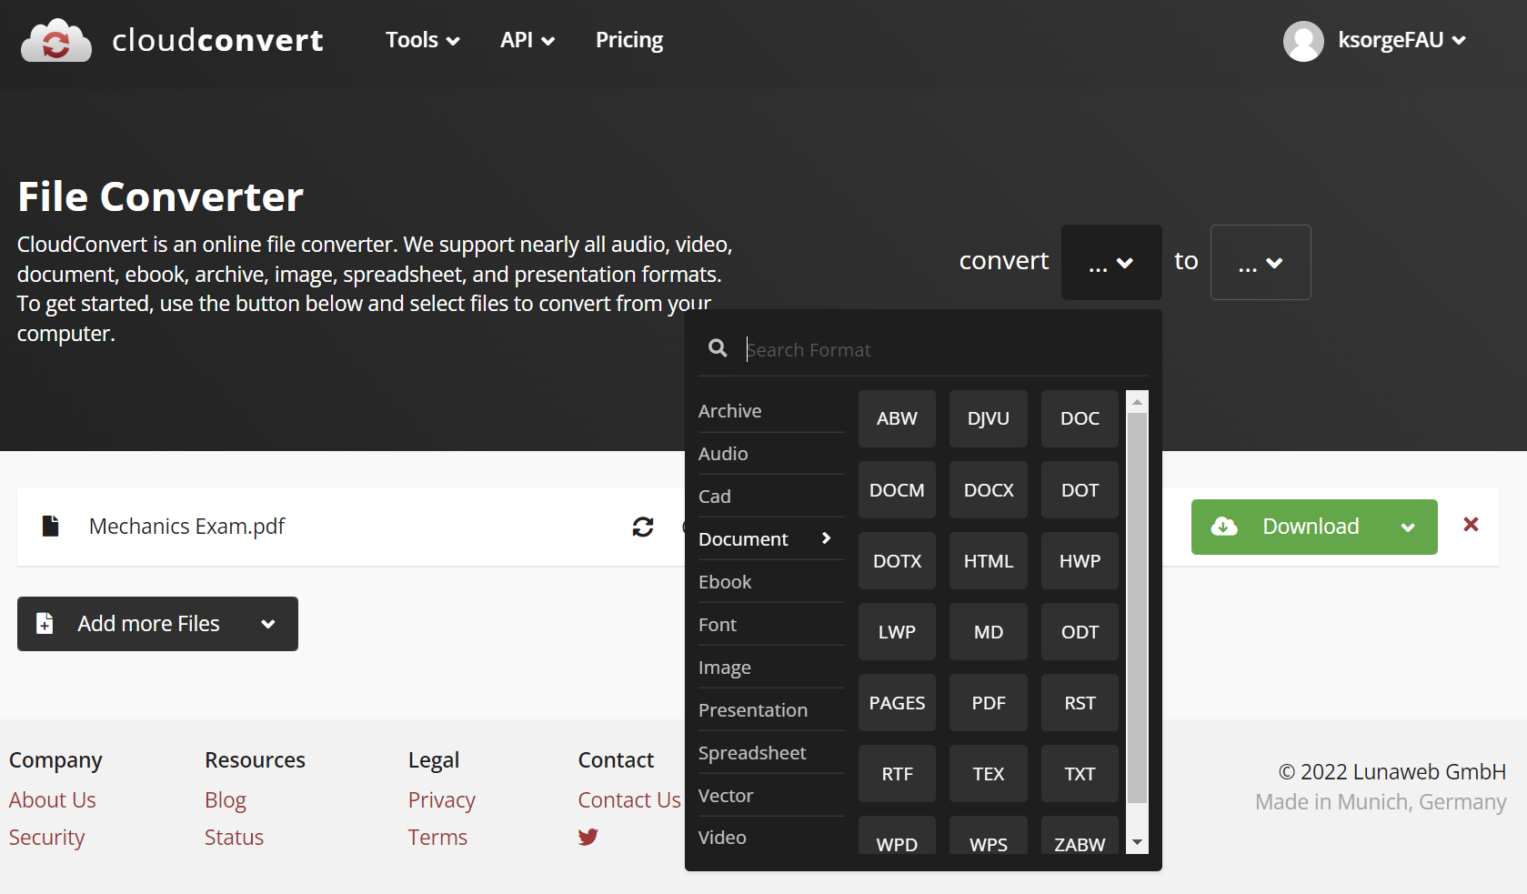
Figures
Greenshot
Screencap stills
CloudConvert
Not just for figures…
Convert pretty much anything to anything else
SVG is a GREAT file type for Canvas. It is a vector graphic, making it infinitely scalable with no pixelation.

Slide 17
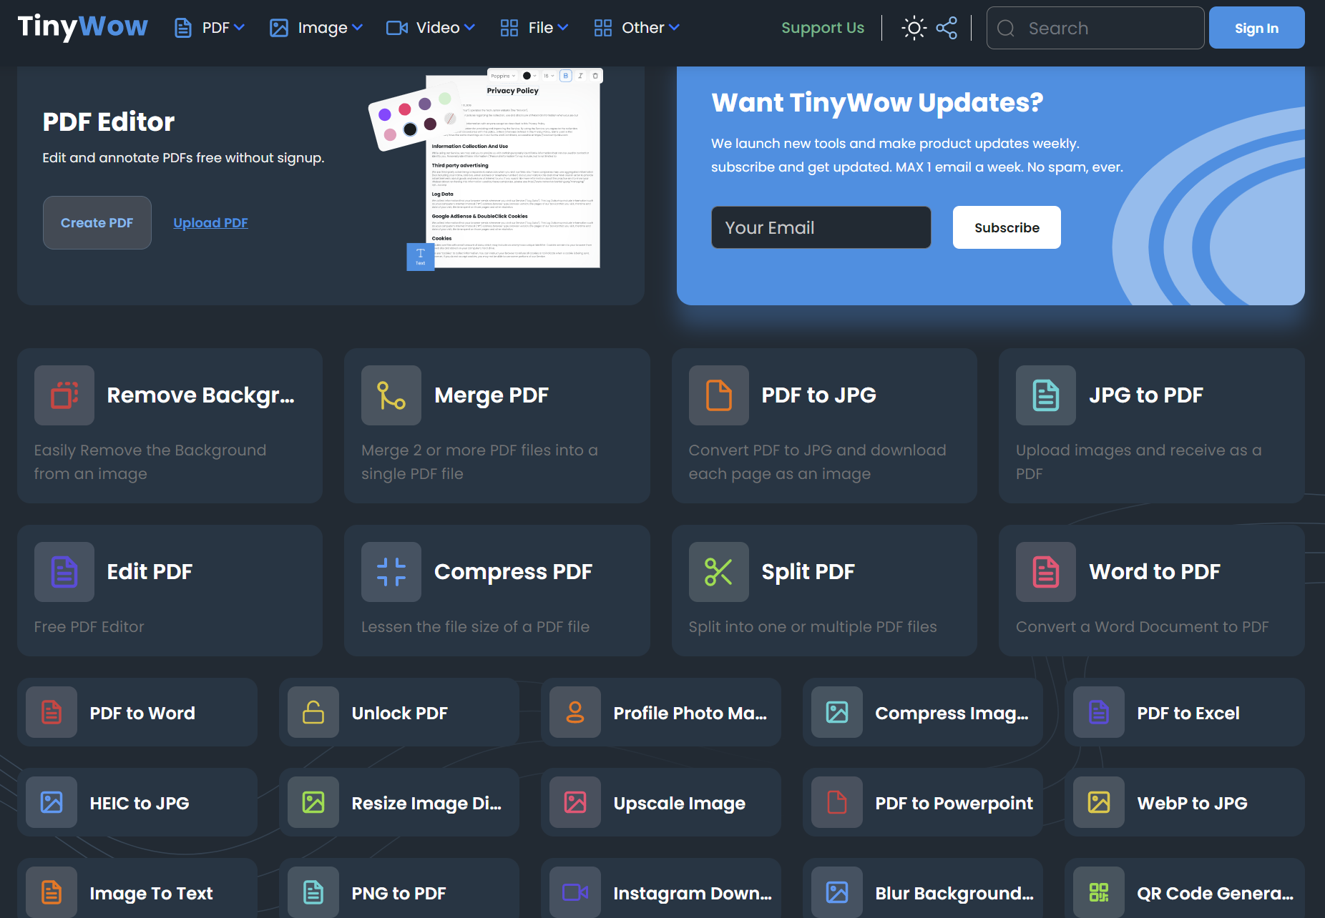
Websites
All Encompassing
Tinywow
CloudConvert
Graphics
Canva
ILovePDF
Transcription
Otter.ai

Slide 18
Organizing Canvas

Slide 19
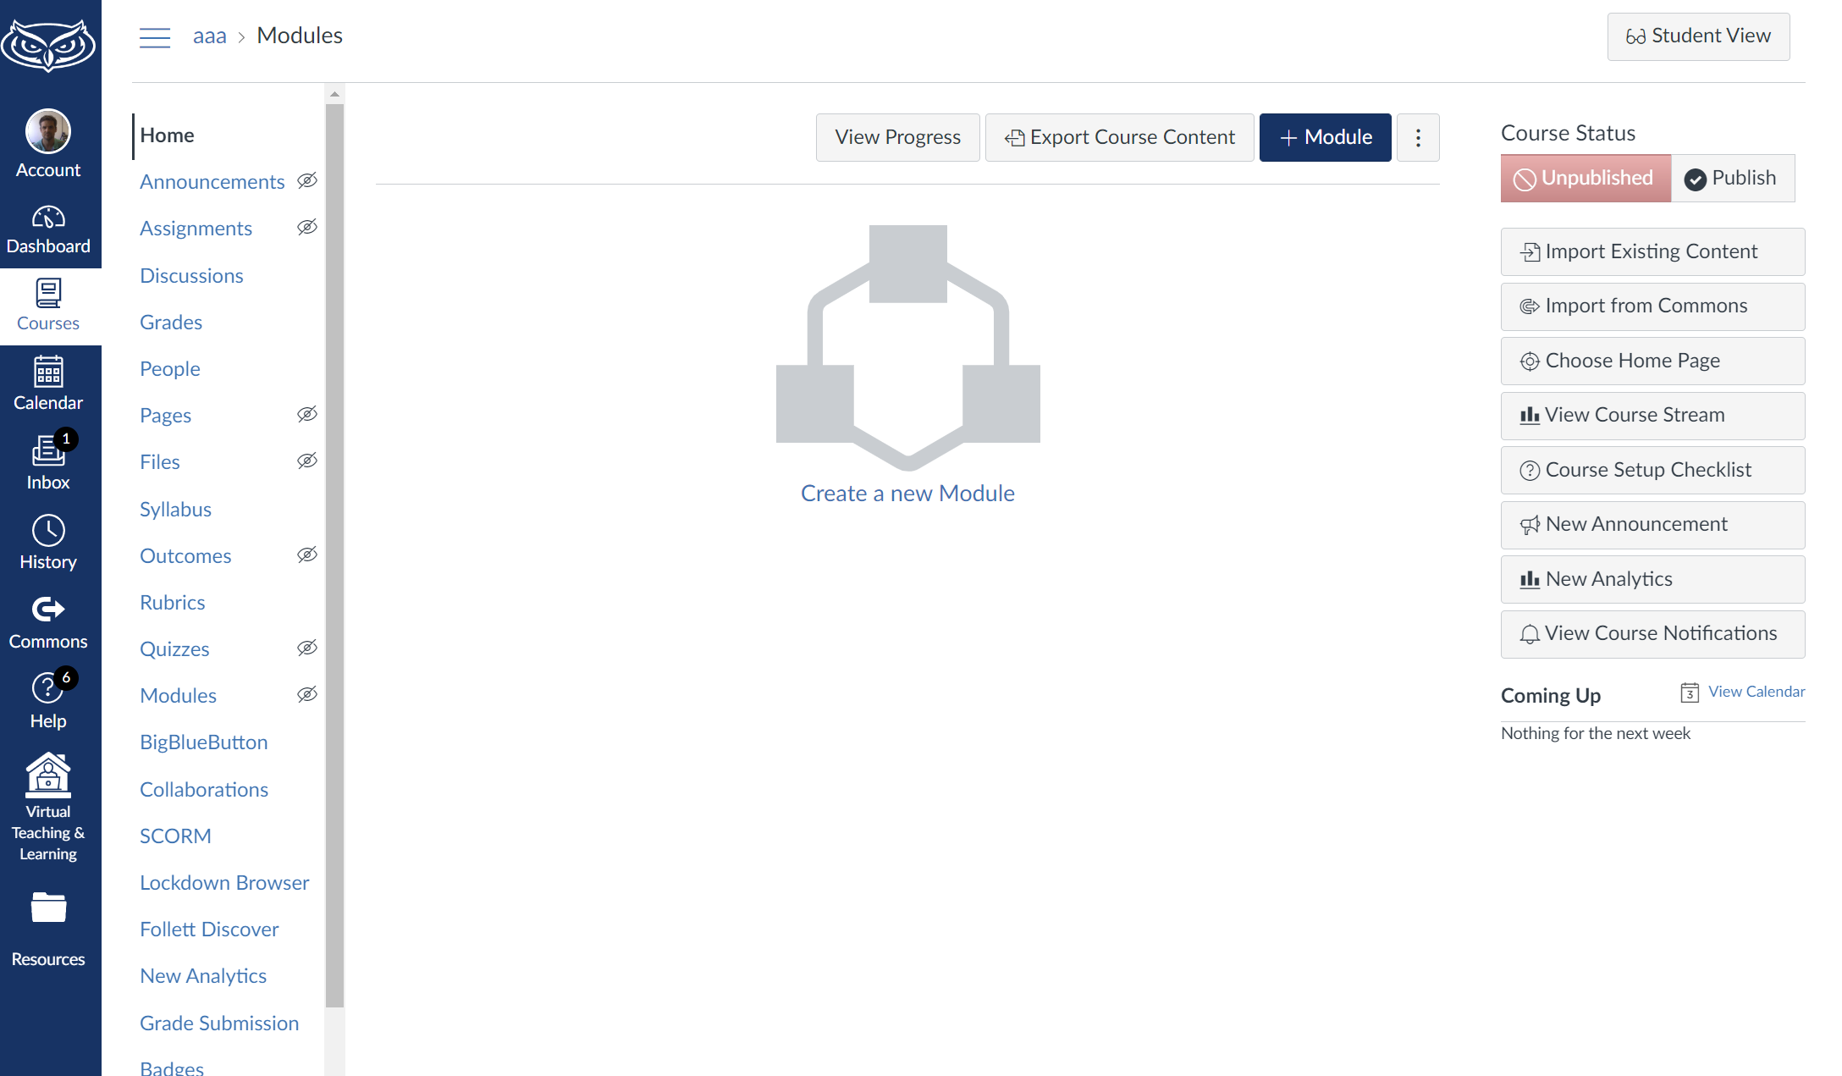
Organizing Canvas
Checklist
File Structure
Modules and Pages
Quizzes (more on this later)
Assignments
Rubrics
SpeedGrader
Gradebook and Grades

Slide 20
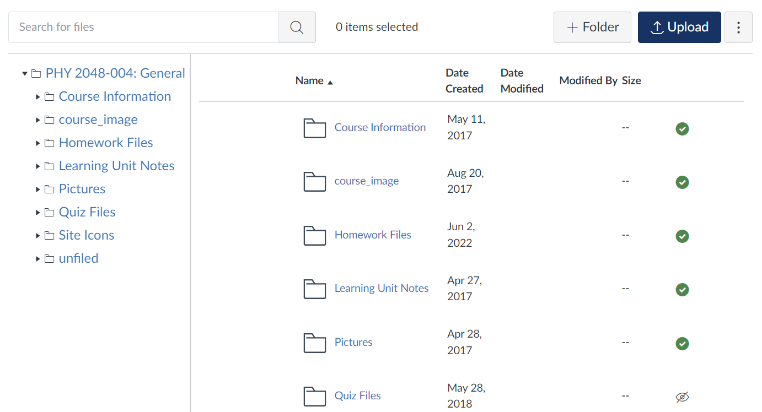
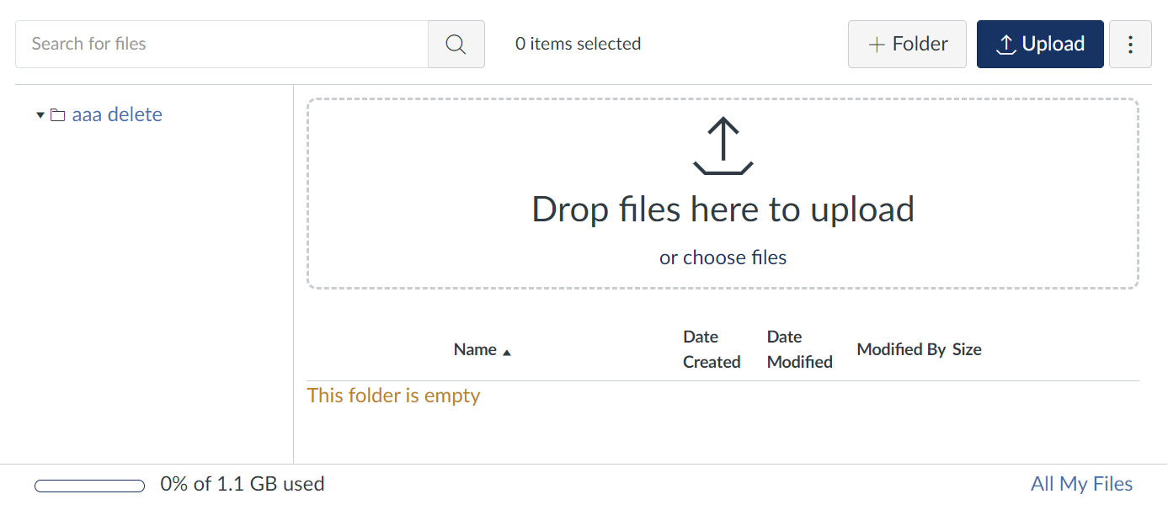
Organizing Canvas
The Canvas File Structure

Slide 21
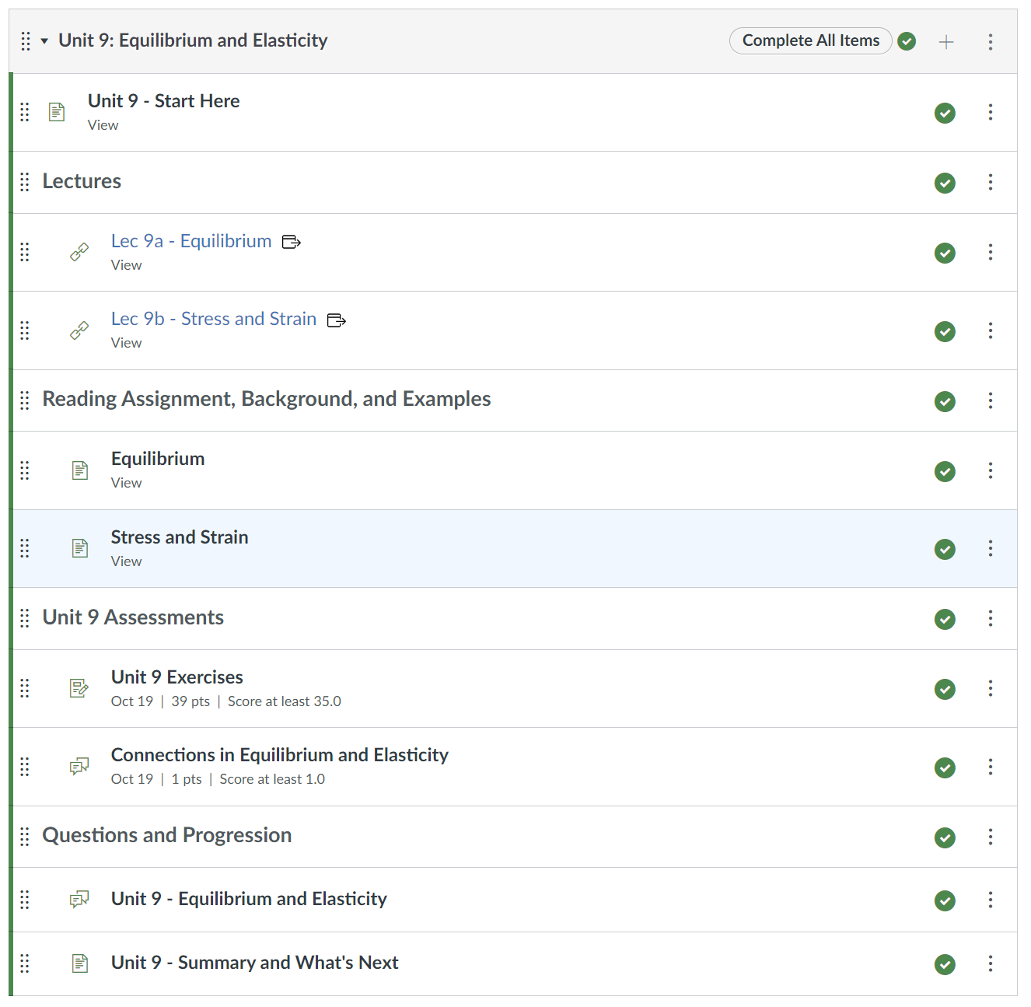
Organizing Canvas
Modules
Pages
Discussions
Video
External Assignments
Text Descriptors

Slide 22
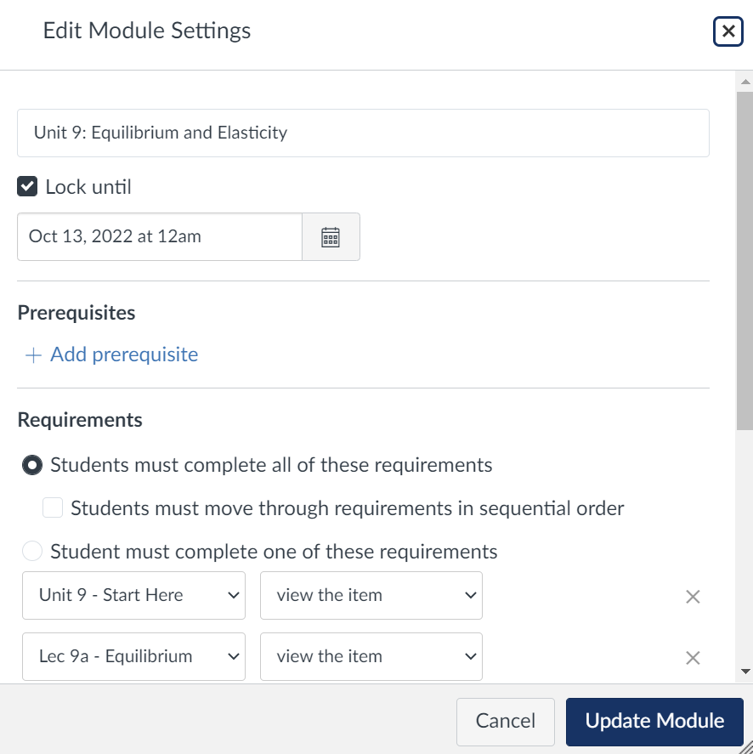
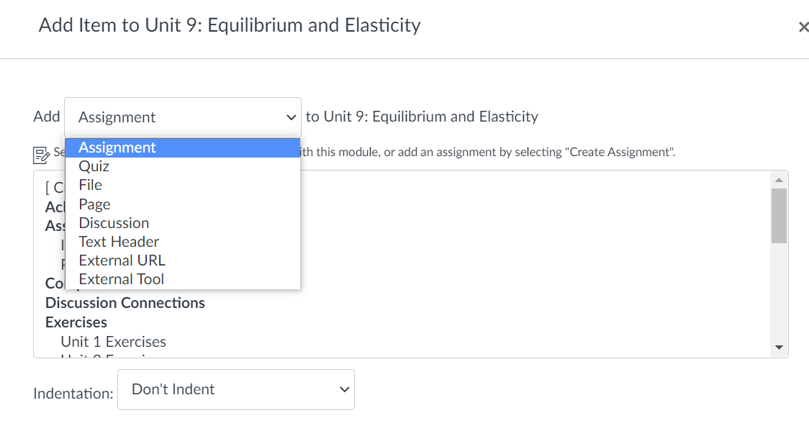
Organizing Canvas
Modules

Slide 23
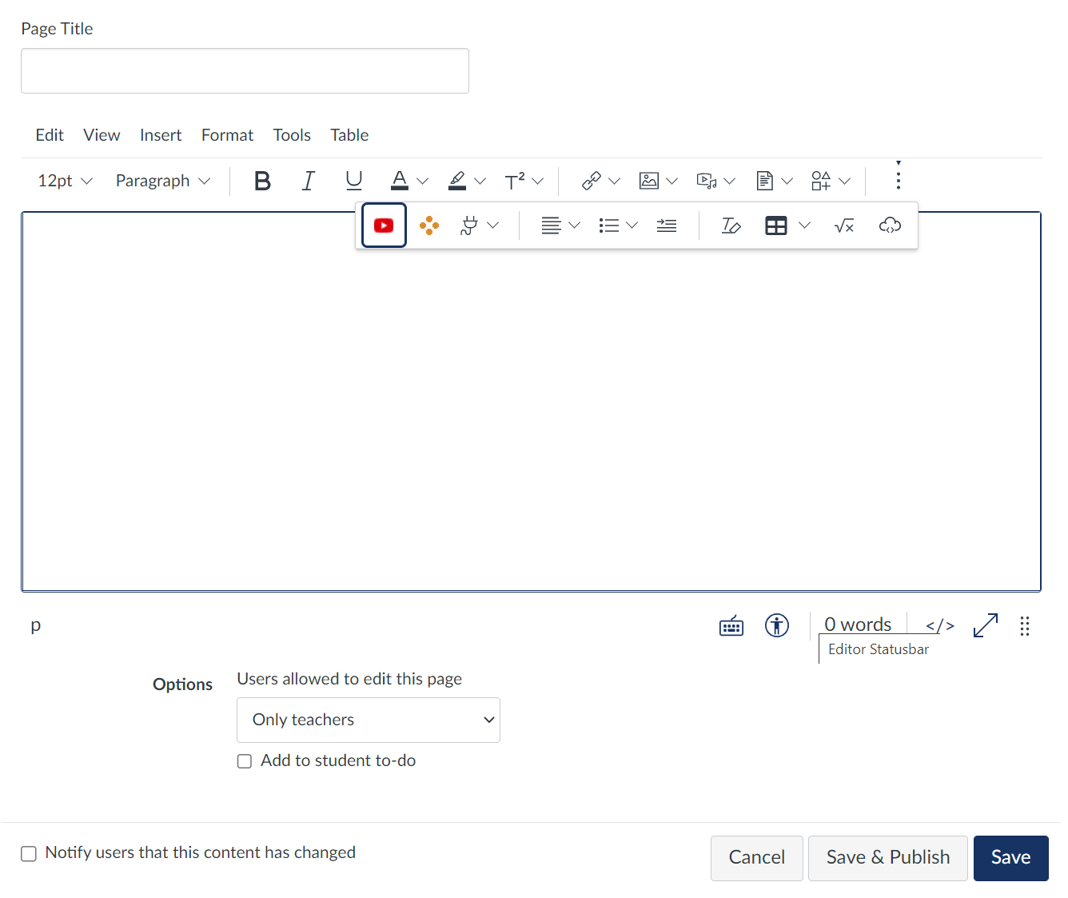
Organizing Canvas
Pages

Slide 24
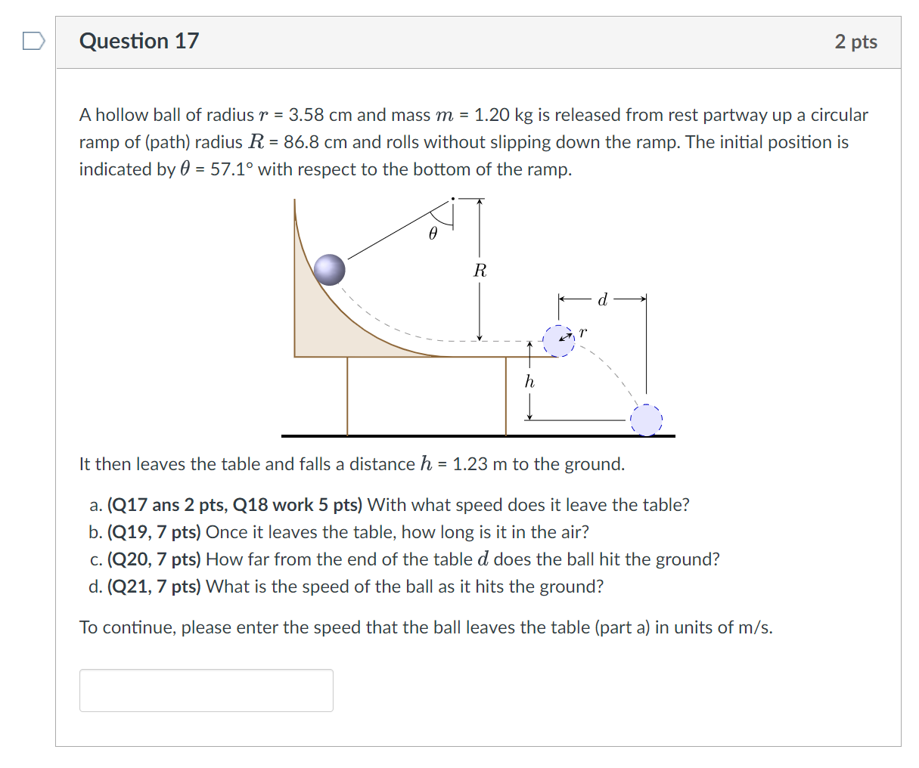
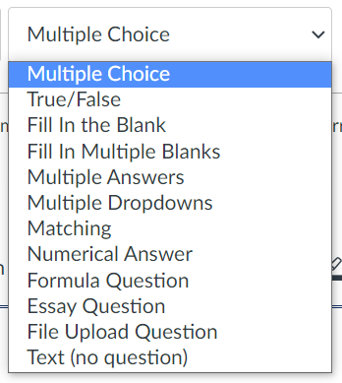
Organizing Canvas
Quizzes

Slide 25
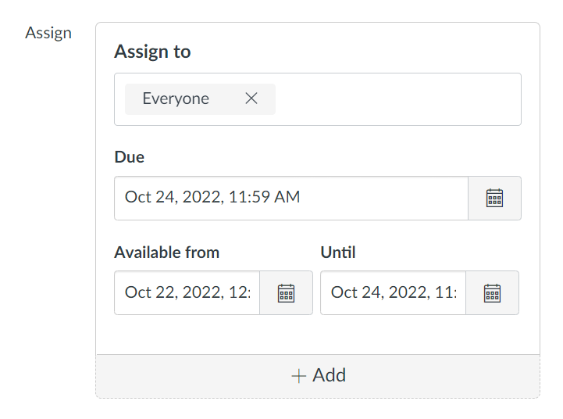
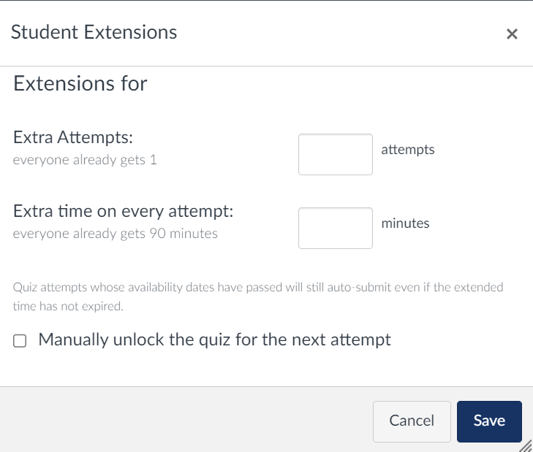
Organizing Canvas
Quizzes

Slide 26
Organizing Canvas
Proctoring
LockDown Browser
Free unlimited use
Webcam and Camera only
Honorlock
A bit more complicated fee structure
Webcam and computer desktop
AI and/or a person proctoring

Slide 27
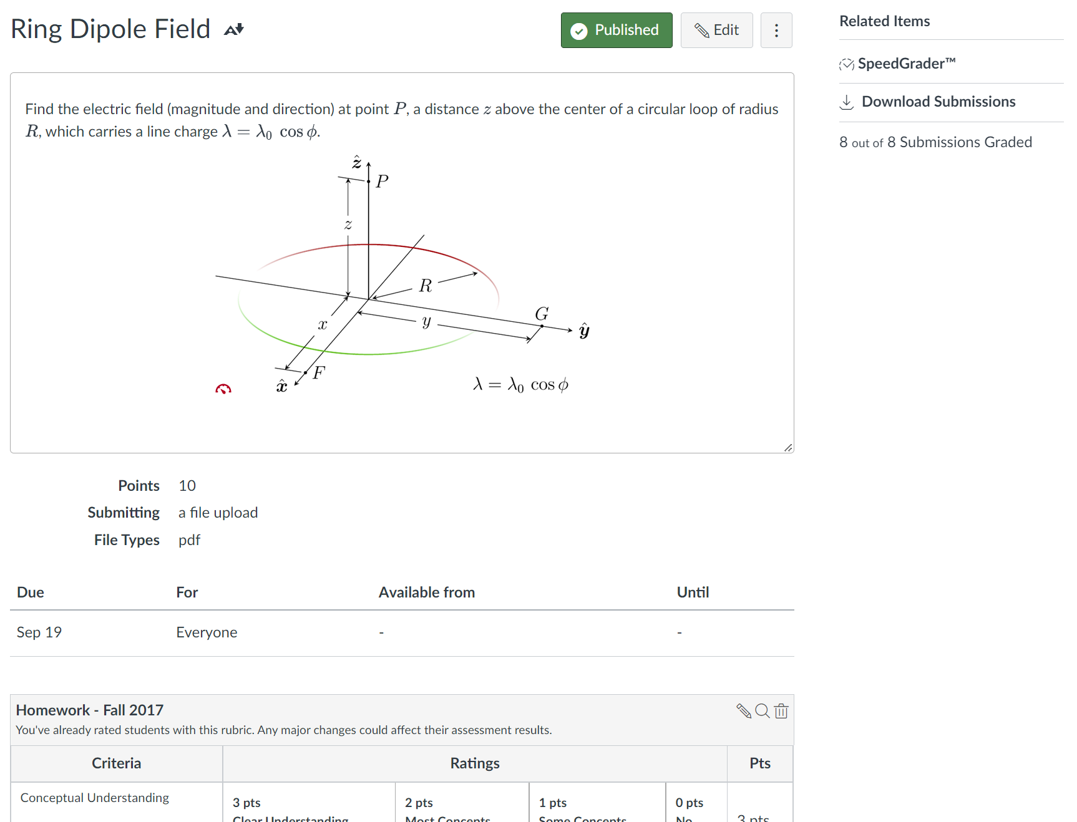
Organizing Canvas
Assignments

Slide 28
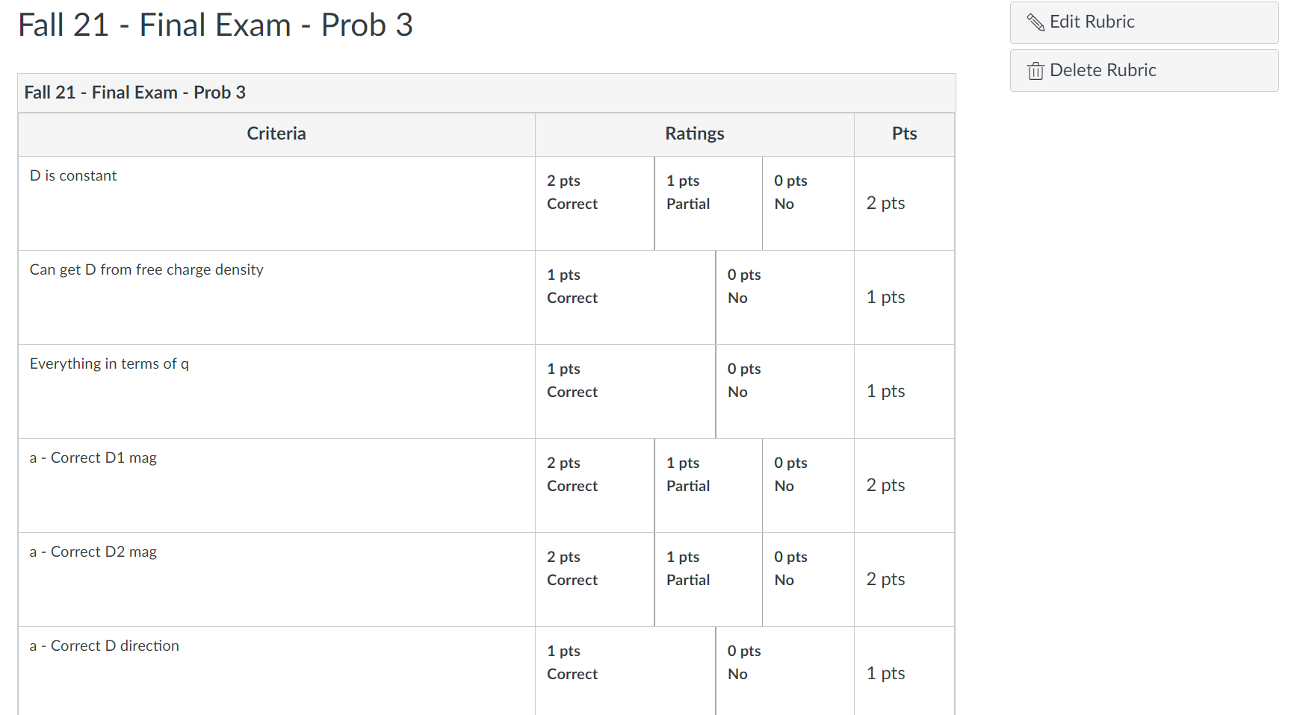
Organizing Canvas
Rubrics

Slide 29
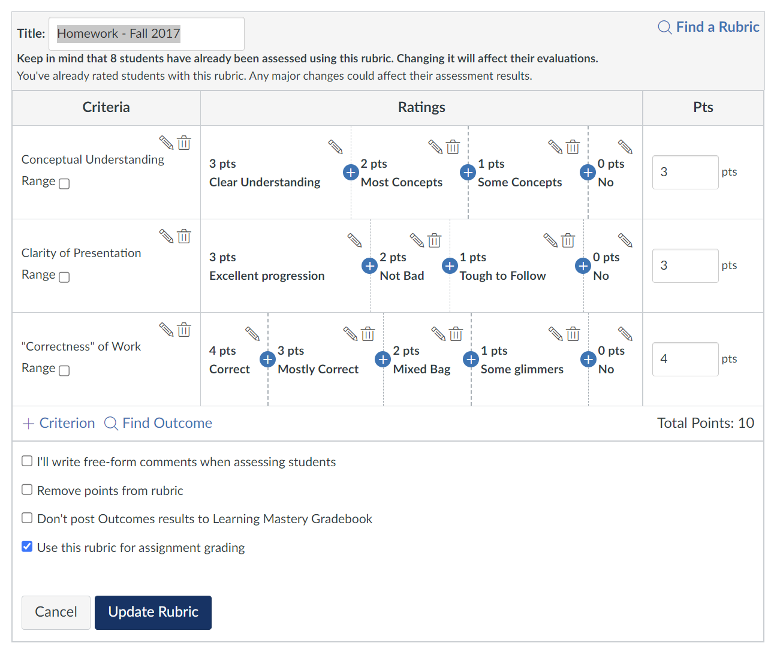
Organizing Canvas
Rubrics

Slide 30
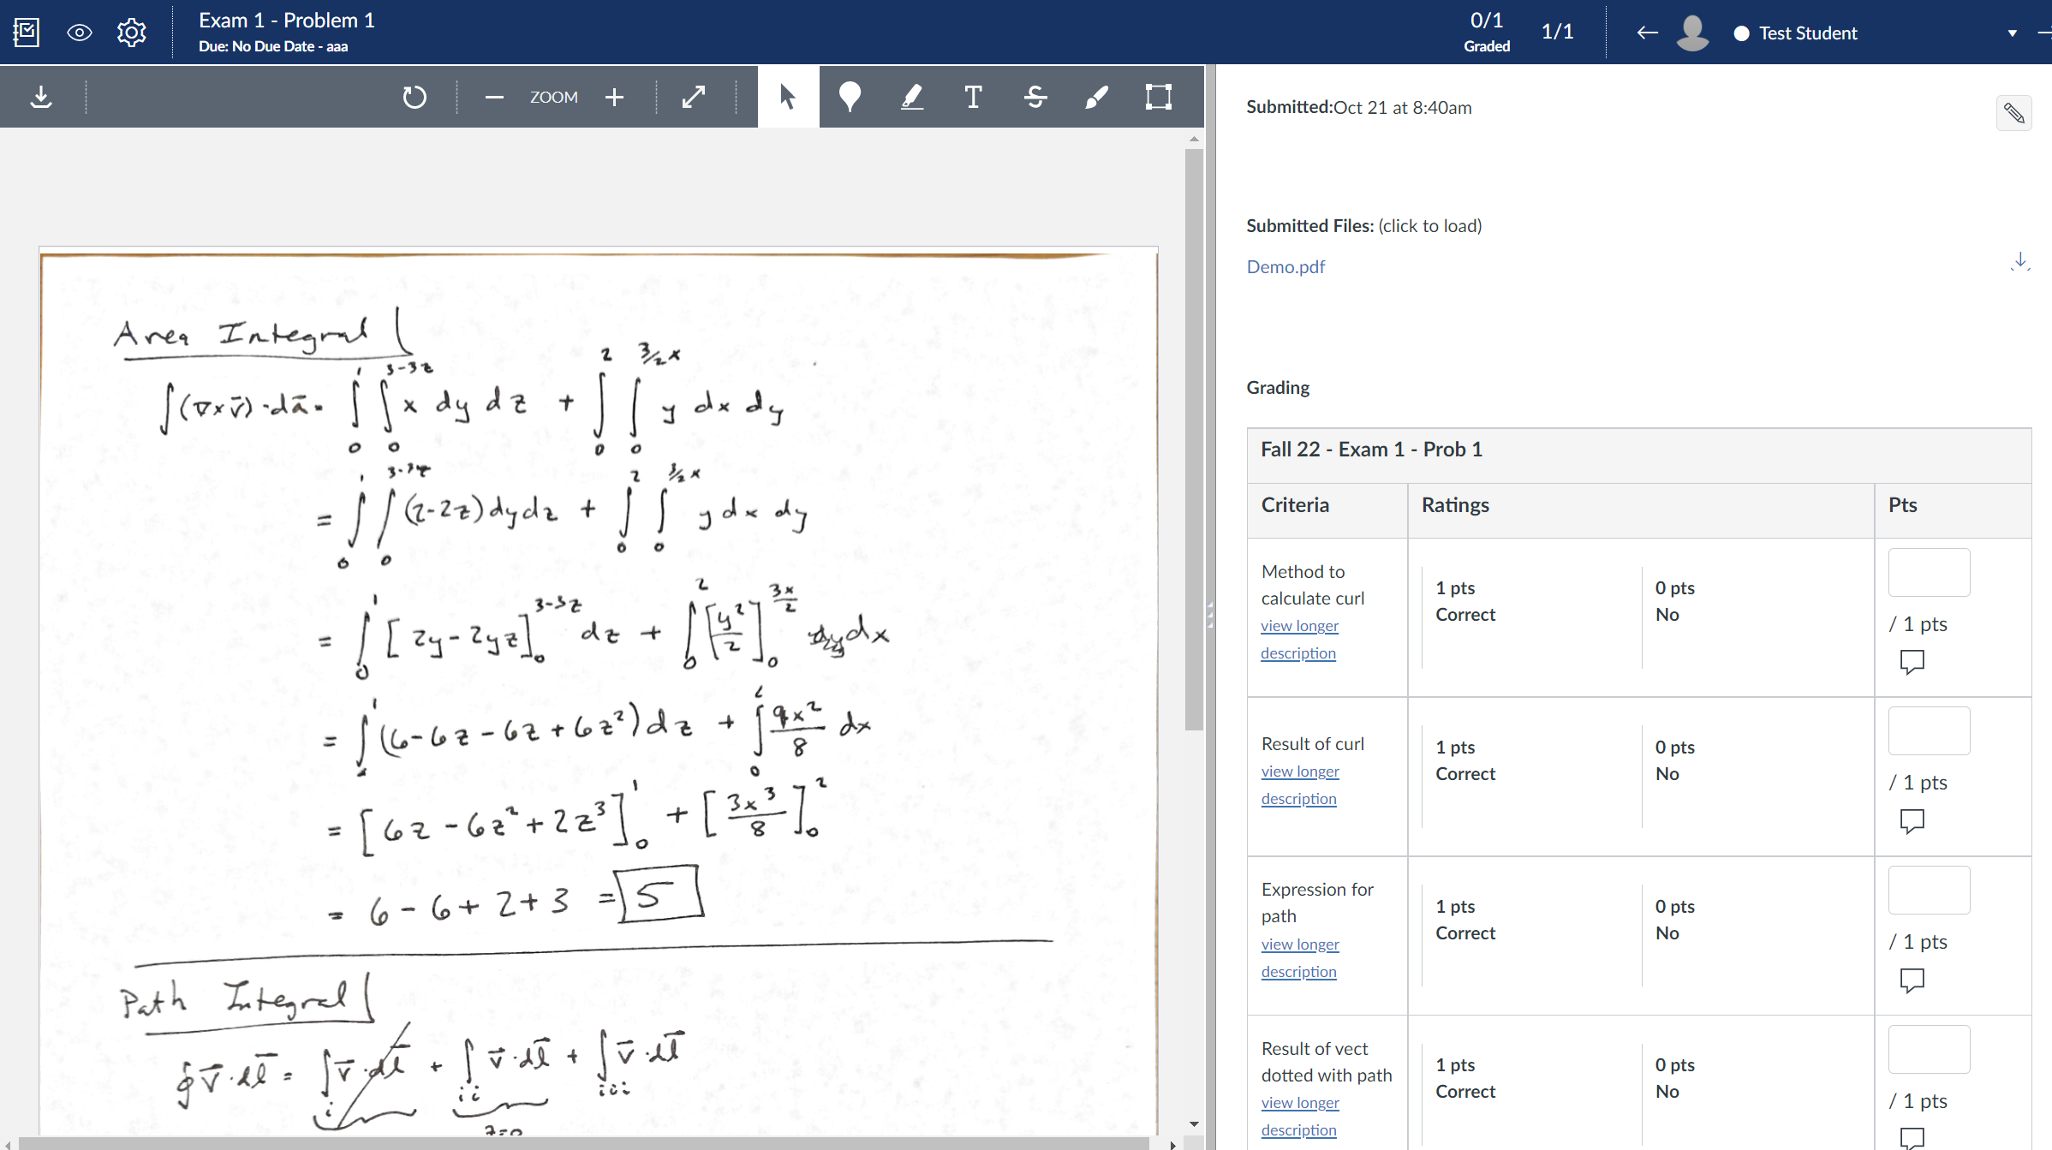
Organizing Canvas
SpeedGrader

Slide 31
Organizing Canvas
Notes
Set “Syllabus” as a landing page
Hide “Files” and “Pages”
Don’t build quizzes or exams in the live shell
For assignments that Canvas doesn’t grade automatically, set Grade Posting Policy to “Manual.”

Slide 32
Class management and Active learning Dr. Donna Marion, Department of Psychology Dr. Papiya Bhattacharjee, Department of Mathematical Sciences

Slide 33
CLASS MANAGEMENT
The syllabus sets the rules – create a strong syllabus and follow it
Treat all students equally
Grading rubrics
SAS accommodations
Absenteeism/makeups
Encourage class attendance
Canvas Roll Call
Live quizzes (e.g., iClicker)
Use Canvas to the students’ advantage!
Program due dates for all assessments. These dates hit the Canvas Syllabus and student academic calendars to help them stay on track.
If the class is fully online, send out broadcast announcements through Canvas frequently – let the students feel your presence.
*
*Offer reasonable accommodations for assessments missed due to religious observation, and those missed due to FAU athletic or club participation with notification from athletic director or faculty club leader.

Slide 34
CREATING AN ACTIVE LEARNING ENVIRONMENT (Things that work for me in both F2F and online classes)
Kick off the semester with a Meet-and-Greet Discussion Board
Topic-driven Discussion Forums
Assigned video or topic prompts
All students or small group debates
Group projects
Breakout sessions F2F or through Webex/Zoom
Group work in Google documents
Writing projects
Turnitin ETS-Rater
Peer-reviews through Canvas Assignments
Encourage visits to office hours outside of class

Slide 35
THINGS I WISH I KNEW ABOUT EARLIER…
Automated grade submission process through Canvas Grades
Student Information in MYFAU -> FAU Self-Service -> Faculty Services
Student Course Schedule
Student College Transcript
Access to Course Schedules by Term (all University courses, by College or by Department) https://app.powerbi.com/view?r=eyJrIjoiMWEwN2QzY2QtMWVjZi00Y2NlLWE1ODMtMmU5NDYzODA2Y2NjIiwidCI6IjYzYzNjOWMxLWU4MjQtNDEzZi1iNDM1LTJmMGNhYmIyODI4ZiIsImMiOjF9&pageName=ReportSection
FAU faculty has free access to a Turnitin account
FAU faculty has free access to Zoom and/or Webex accounts

Slide 36
FAU RESOURCES FOR TEACHING AND LEARNING
KEEP TEACHING
https://www.fau.edu/keep-teaching/get-help/
KEEP LEARNING
https://www.fau.edu/keep-learning/campus-resources/

Slide 37
RECOMMENDATIONS FOR ONLINE TESTING TO MAINTAIN ACADEMIC INTEGRITY (and help protect against distribution of your test questions)

Slide 38
LOCKDOWN BROWSER
Consider using Canvas Test Banks
Customize the Canvas Test
Fix a reasonable test time for your type of test (there are pedagogical guidelines), within a narrow window that the test stays open*
On multiple-choice tests
Show one question at a time
Ability to backtrack on multiple-choice tests is discouraged
Randomize response options for each student on multiple-choice tests
Customize LockDown Browser Settings
Specify any files or websites you want students to be able to access during testing
Edit instructions students see during their test set up
Webcam recommended
Require FAU ID for testing
*If you have fixed exam times in a fully online course, consider sending announcements of the fixed test times/days to all enrolled students each month after registration opens until the course begins – this enables students to address /resolve any conflicts.

Slide 39
LOCKDOWN BROWSER WITH WEBCAM
BEFORE TESTING
Set up a practice test that students can take multiple times, and encourage students to use it
Preannouncements
emphasize academic integrity
describe test format and testing rules
let students know what they should do if they encounter technical difficulties during testing
DURING TESTING – MONITOR THROUGH ‘MODERATE THIS QUIZ’
See who’s testing and who is not (and each student’s remaining time)
See exactly when a particular student began testing, where they are in the test, how long they have spent on each question and periods students stopped viewing (potential technical difficulties)
AFTER TESTING
Review of webcam recordings
Follow up on any perceived dishonesty (Important – word travels quickly! )

Slide 40
Regulation 4.001 – FAU Code of Academic Integrity Should you encounter academic dishonesty, please read full details of the Code at the below link (information presented here is paraphrased and condensed): https://www.fau.edu/regulations/documents/chapter4/reg4-001-6-7-22.pdf
When you have a reason to believe dishonesty has occurred:
Advise the student in writing that you need to meet with them about a perceived violation of academic integrity.
Meet with the student to present your perception of the facts and the sanction you will impose. [In some situations, this meeting on the incident may occur without the written notification in Step 1, which is okay.]
If after the meeting you continue to believe that the student engaged in academic dishonesty (or if the student has failed to respond after 10 business days of your written request for a meeting), you should provide the student written notice of the allegation, the penalty, and a link to Regulation 4.001 (rev 6/7/22). The notice of allegation should be provided within 10 business days of the meeting, unless you notify the student that additional time is needed. A copy of the allegation must be sent to the chair/director of the department administering the course.

Slide 41
What Happens Next?
If within 5 business days of the notice of allegation the student notifies the chair/director that they would like to be heard, the chair/director will schedule a meeting with the student and you.
If the allegation is not resolved in a meeting with the chair/director, the student and you, the student has further rights of appeal to the dean of the college, and finally up to the University Provost. Procedures for each step of the appeal process are spelled out in the Code. [Read the Code!]
If the student fails to timely pursue the appeal process at any point, or if there is an ultimate finding by the Provost (through the appeal process) that the Code of Academic Integrity has been violated, the chair will notify the University Registrar that the following notation be included on both the student’s academic transcript and on the student’s internal record: “Violation of Code of Academic Integrity.”
First offenders that elect to (and successfully) complete an Academic Integrity Seminar by the end of the semester following the academic dishonesty can get the notation regarding an academic integrity violation removed from their official transcript (but this does not change any instructor-imposed penalty and neither withdrawals nor forgiveness policies can remove a resulting “F”).
Repeat offenders will be expelled.

Slide 42
Enforce Academic Integrity! Why?
A student’s ability to learn and grow is harmed when you don’t enforce the Code – cheaters seldom learn what is needed for true success.
As numbers of students earning a degree through academic dishonesty increase, the meaning of a college degree decreases.
Students with integrity who work hard for their grades are disrespected when others are allowed to receive good grades through cheating.
Consequences for a first-time cheater promote learning about academic integrity and an opportunity future growth.
Consequences for a second offense results in expulsion.

Slide 43
Student learning assessment Dr. Yanmei Li, Department of Urban and regional Planning

Slide 44
Student learning assessment
Defining Course Objectives
Formative vs. Summative Assessment
High Stakes vs. Low Stakes Assessment
Quantitative vs. Qualitative Assessment
Rubrics

Slide 45
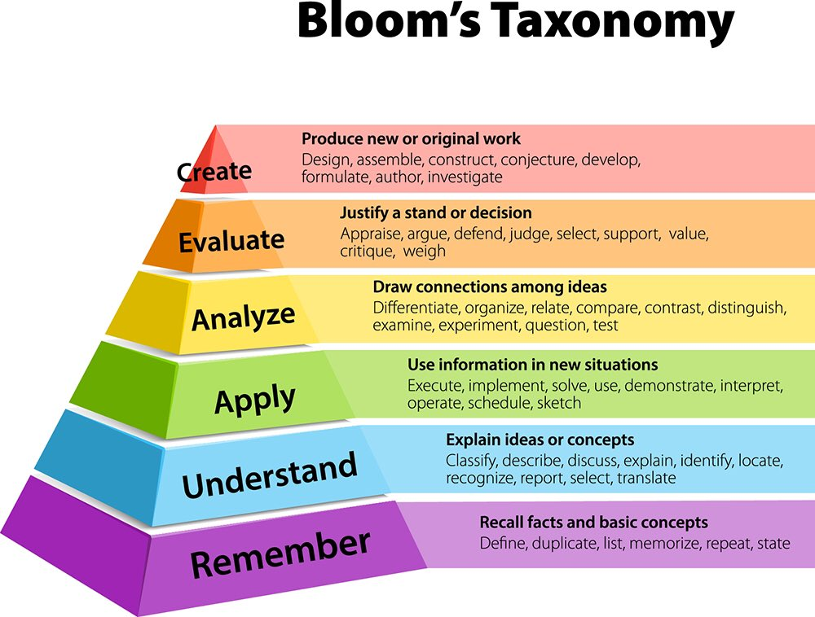
Defining course objectives
Align with University SLOs (Student Learning Outcomes) and/or program accreditation guidelines
Use Bloom’s Taxonomy action words in writing course objectives
This Photo by Unknown Author is licensed under CC BY-SA-NC

Slide 46
Bloom’s Taxonomy Action Words (selected)
Knowledge | Understand | Apply | Analyze | Evaluate | Create
Define Describe Identify Outline Memorize Review Reproduce … | Articulate Clarify Classify Compare Contrast Demonstrate Differentiate Describe Explain Illustrate Summarize Paraphrase … | Construct Demonstrate Develop Generalize Organize Predict Utilize … | Analyze Break down Categorize Classify Compare Contrast Criticize Dissect Examine Distinguish Infer Predict Relate … | Assess Appraise Conclude Compare Contrast Estimate Evaluate Explain Probe Prepare Rewrite Verify Synthesize … | Assemble Collect Combine Compile Construct Facilitate Hypothesize Modify Organize Propose Revise Synthesize …

Slide 47
COURSE OBJECTIVES/STUDENT LEARNING OUTCOMES: An example
Upon successful completion of this course, students will be able to:
Analyze the different aspects of urban dimensions (e.g.: physical, sociodemographic, economic, cultural, political structure and public policies).
Explain the basic contours of urban growth and change, including an appreciation of underlying dynamics and influences, to achieve an understanding of implications for theory and for planning practice.
Identify the evolution of urban morphology, the process of shaping and reshaping of the urban form, and factors causing changes to the urban environments.
Outline how the different aspects of urban dimensions relate and interact with each other.
Compare how cities are structured and organized in a global context.
Evaluate the principal dimensions of urban transformation (e.g.: economic, social, cultural, physical, environmental, and spatial) and the key interdependencies among these facets of urban change.

Slide 48
Formative vs. Summative Assessment
Formative: Focus on the learning processes
e.g. Clicker quizzes on material studied for class, midterm surveys about what is going well or poorly in the class, journals or logs maintained by students, counts of meetings between students or between students and faculty, count of time spent studying or preparing for class
Summative: focus on the learning outcomes
e.g. Completed student work (paper, project, homework, etc.), final grades on exams, grades that are linked to learning outcomes, course or program portfolio, course or program evaluation

Slide 49
High Skates vs. Low Stakes assessment
High Stakes | Low Stakes
Enables students to demonstrate competency, strengths, and synthesis of course objectives across the full course. | Enables students to practice and learn from mistakes; typically focused on a specific element or content in a course.
High percentages of course grades associated with fewer major assessment points and therefore fewer feedback points. | Lower percentage of course grades associated with multiple assessments; feedback for improvement is provided.
May not provide learners with feedback early in the course, so they are unaware of how they are doing, what their strengths are and where they may need to improve. | Allows learners to know how they are doing early in the semester and throughout the semester: identifies what they are doing well where and how to improve, etc.
There is high stress points as fewer assessments are used. | May be less stressful, as they are perceived at a lower value.
Increased workload at concentrated times in the term. This tends to be a challenge as high stakes assessments are assigned at typical times in the term (i.e. mid-term, end of the course) | Steady workload spread out over the course of the term. This can be a particular challenge for students taking more than 2 courses.
Examples: Mid-term exams, final exams, major papers and presentations. | Examples: Contributing to discussion posts, mastery learning quizzes, and one-minute papers.
Center for Innovation in Teaching and Learning, Memorial University. (2022). High Stakes and Low Stakes Assessment. https://blog.citl.mun.ca/instructionalresources/high-stakes-and-low-stakes-assessment/

Slide 50
High-Stakes Assignments
If you want to assess students'... | Then assign or give
Ability to define key course terminology and recall facts | Writing assignments that require appropriate use of disciplinary or course terminology Exams with Fill-in-the-blank questions Matching questions Multiple choice questions Short answer questions
Synthesis of key course concepts | Case studies Debates Essay exams Final projects Multiple choice questions Presentations Portfolios Research projects Simulations
Application of discrete research, technical, performance, or meta-cognitive skills | Writing projects Case studies Debates Performances Presentations Simulations
Ability to transfer knowledge or skills and apply them to new situations | Writing projects Case studies Debates Simulations
Creation of new knowledge | Portfolios Video essays Artwork Websites Presentations Research projects Thesis or dissertation

Slide 51
Low-stakes assignments
Quizzes
Discussions
Journaling
Breaking Down Larger Assignments
Early Drafts and Peer Review
Mid-Project/Quarter Conferences
Group Work Planning and Reflection
* Both of the high-stakes and low-stakes examples are taken from Teaching Commons, DePaul University.

Slide 52
Quantitative and Qualitative Assessment
Quantitative Measures | Qualitative Measures
Test scores Rubric scores Average response on scaled survey items Counts of student presentations and publications … | Reflective writing Patterns observed in student behaviors Notes from interviews or focus groups Class discussion threads …

Slide 53
Rubrics
An assessment tool to indicate achievement criteria across each component of student work
Has three main parts:
Competency criteria
Rating scale
Indicators
Value Rubrics from AAC&U (American Association of Colleges and Universities): https://www.aacu.org/initiatives/value-initiative/value-rubrics
Give the rubrics to the students as part of the assignment guideline
Incorporate Rubrics into Canvas

Slide 54
Summary of Teaching related resources
FAU Instructional Memoranda and Policies: https://www.fau.edu/provost/resources/policy-memoranda/
FAU Faculty Handbook: https://www.fau.edu/provost/documents/university-faculty-handbook.pdf
OIT Instructional Resources: https://www.fau.edu/oit/instructional/
Center for Teaching and Learning: https://www.fau.edu/ctl/
College of Science Advising Services: http://science.fau.edu/student_services/index.php
Keep Teaching: https://www.fau.edu/keep-teaching/
Keep Leaning: https://www.fau.edu/keep-learning/campus-resources/
Center for Online and Continuing Education: https://www.fau.edu/elearning/
Center for Excellence in Writing: https://www.fau.edu/ccew/
Student Accessibility Services: https://www.fau.edu/sas/
Regulation 4.001: https://www.fau.edu/regulations/documents/chapter4/reg4-001-6-7-22.pdf
National Center for Faculty Development and Diversity: https://www.fau.edu/provost/for-faculty/professional-development/national-center-for-faculty-development-and-diversity/

Slide 55
Any questions or concerns please contact: Yanmei Li, yli22@fau.edu
This Photo by Unknown Author is licensed under CC BY-SA

