Slide 1
Novelution Financial Conflict of Interest Module (FCOI)
Presented by: The Office of Research Integrity &
The Office of Sponsored Programs

Slide 2
Introducing the Novelution FCOI Module
What is the FCOI Module
Novelution’s robust Financial Conflict of Interest (FCOI) module provides seamless electronic disclosure and management for both annual “Significant Financial Interest” (SFI) and “Project-Specific Disclosures”. All disclosures will now be submitted, reviewed, managed, and approved electronically and will be centrally housed within Novelution.
Key Benefits
Seamless disclosures, management, and transparency that reduces investigator burden
Replaces the traditional SFI “paper” or “PDF” disclosure form
Eliminates having to print & scan/email/pass around the SFI disclosure form for signatures
Eliminates the requirement of having to submit a SFI disclosure form for each proposal
SFI disclosures are valid for 12 months with updates/renewal accessible any time

Slide 3
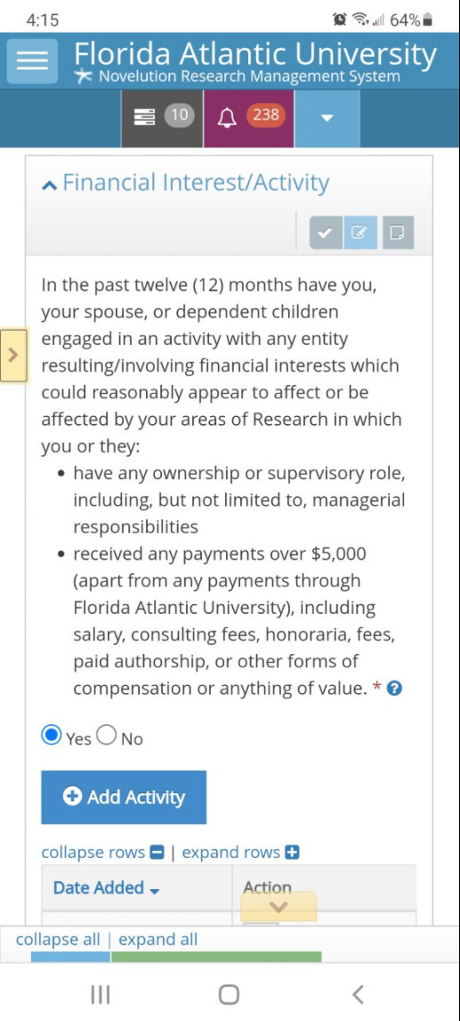
Novelution’s Additional Benefits
Additional Key Benefits
Since Novelution is web-based, it can be accessed anywhere there is an internet connection and users can update their FCOI disclosures utilizing their FAU Single-Sign-On username and password
In-system task reminders when a SFI or Project-Specific Disclosure is required
The FCOI Module works directly with the Sponsored Research Module which makes FCOI routing requirement seamless
Project-Specific Disclosures are only required if the project has been awarded and if there was a SFI disclosed
Each SFI update/renewal automatically extends the disclosure to be active for an additional 12 months

Slide 4
August 2, 2021
“Soft Launch” Date
Optional Novelution submission
Not required at this point, paper submission is ok
FCOI Tab will appear in the system for use of the module

Slide 5
FCOI Novelution Module Training Dates
Friday, August 6th at 3:00pm
Thursday, August 19th at 3:00pm
Wednesday, September 1st at 3:00pm

Slide 6
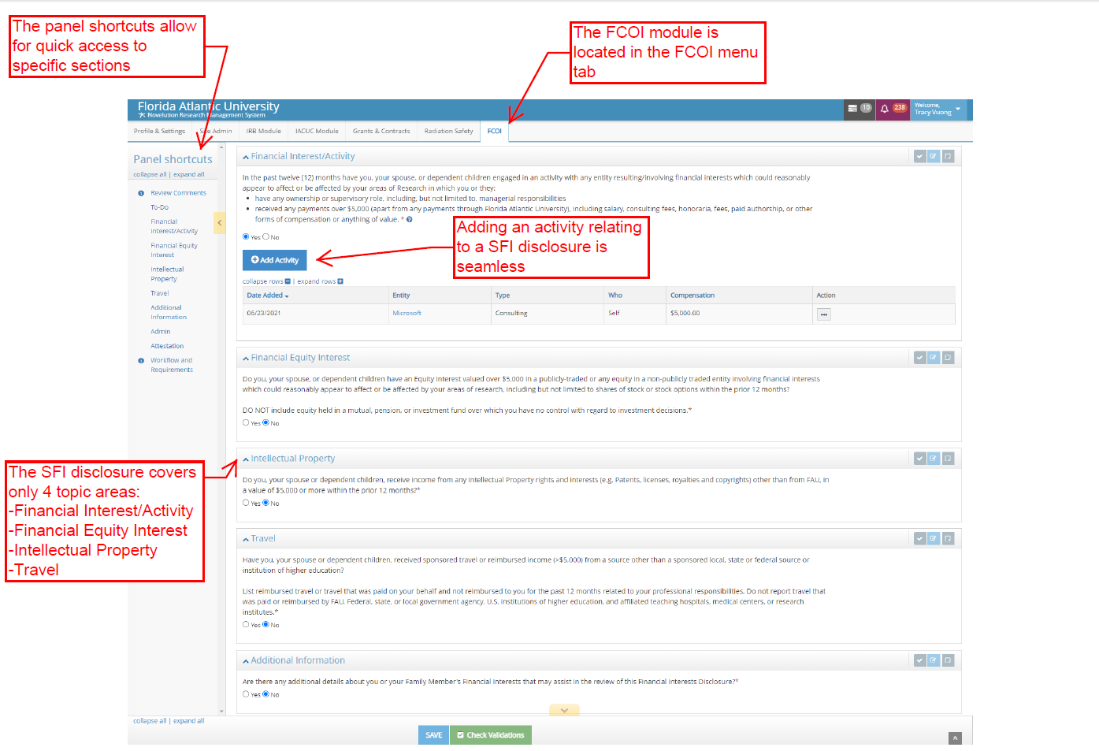
Novelution FCOI Module Interface and How to Navigate

Slide 7
Significant Financial Interest (SFI)
Is now a two part process:
SFI disclosure (at the time of proposal submission)
Project-Specific disclosure (at the time of award)

Slide 8
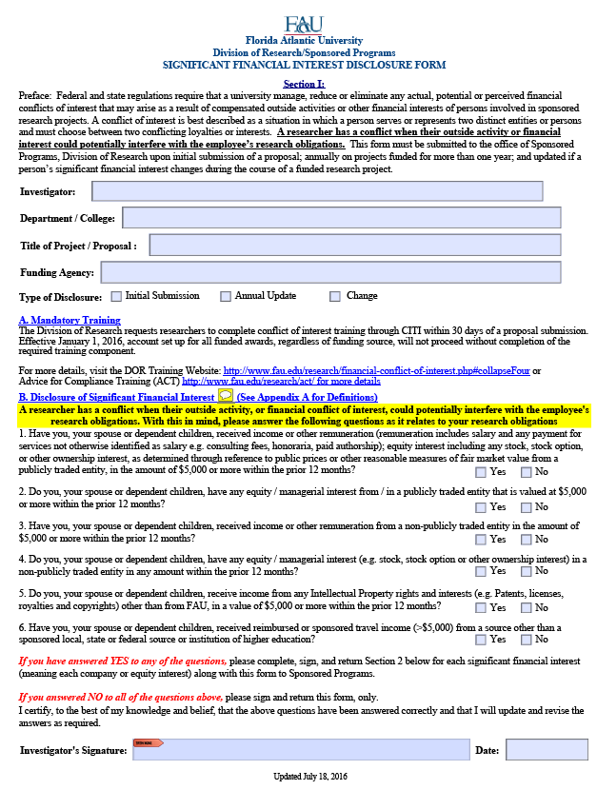
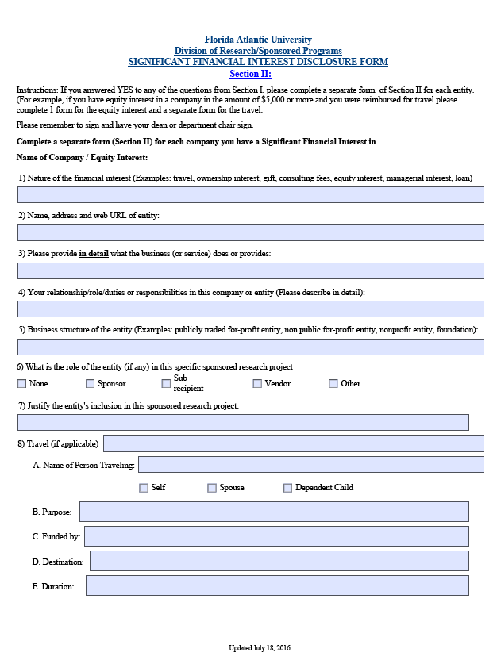
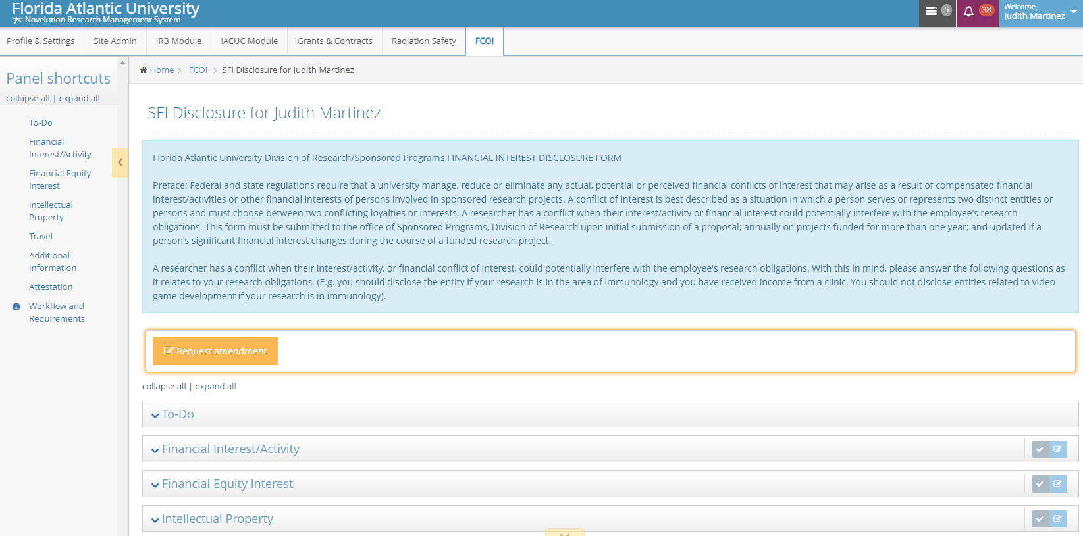
The first two pages of the paper form are now the first part of the disclosure process in Novelution
[Expanded views on the next slides]

Slide 10
Part B of the SFI disclosure in paper form

Slide 11
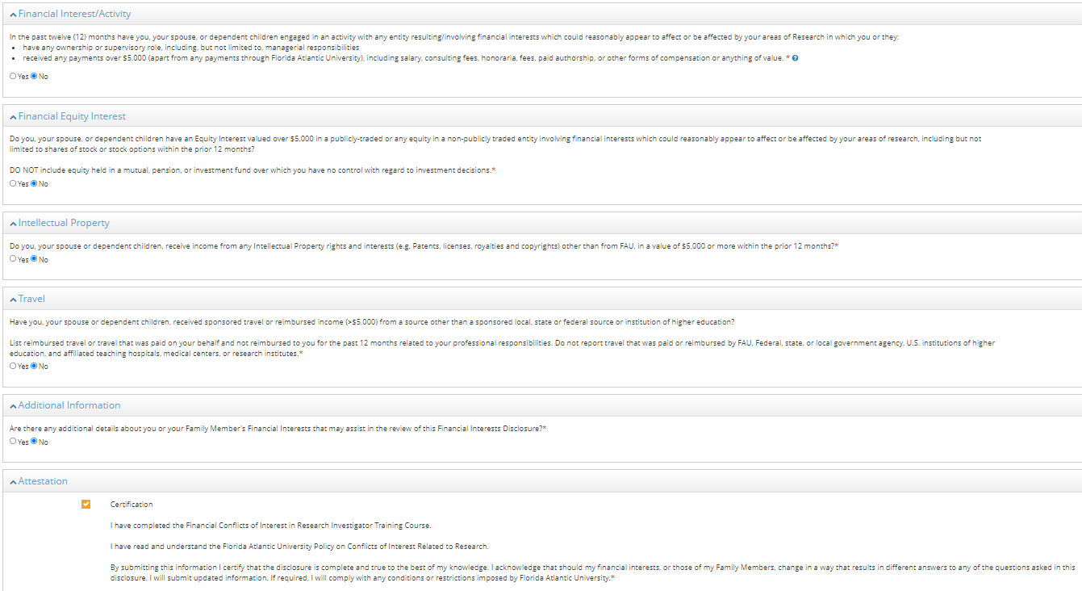
Part B of the SFI disclosure in the Novelution form

Slide 12
Section II (questions 1-8) of the paper form will now appear as a blue button option to add interests when there is a “yes” answer to any of the categories

Slide 13
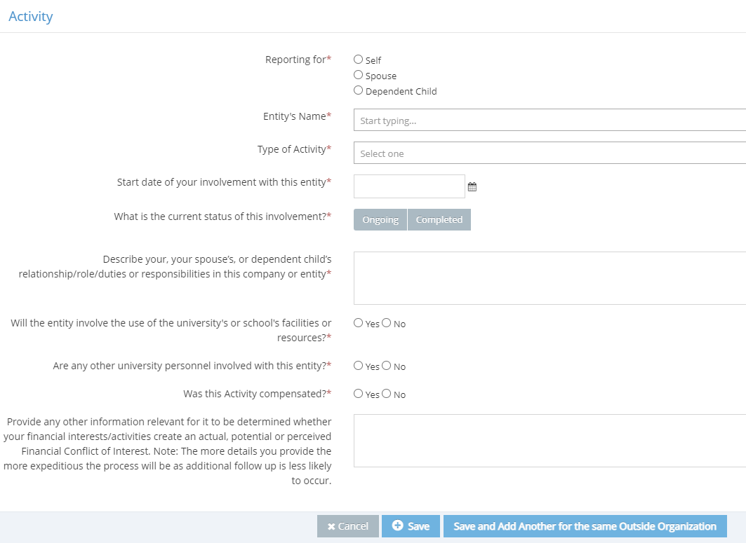
Disclose an outside activity (consulting, organization, etc.). This information is completed ONCE and automatically links to the researcher’s account. Think of it as a “User Profile”. FCOI reviewers will be able to see these entities

Slide 14
Disclose an equity interest (stocks/shares, etc.)

Slide 15
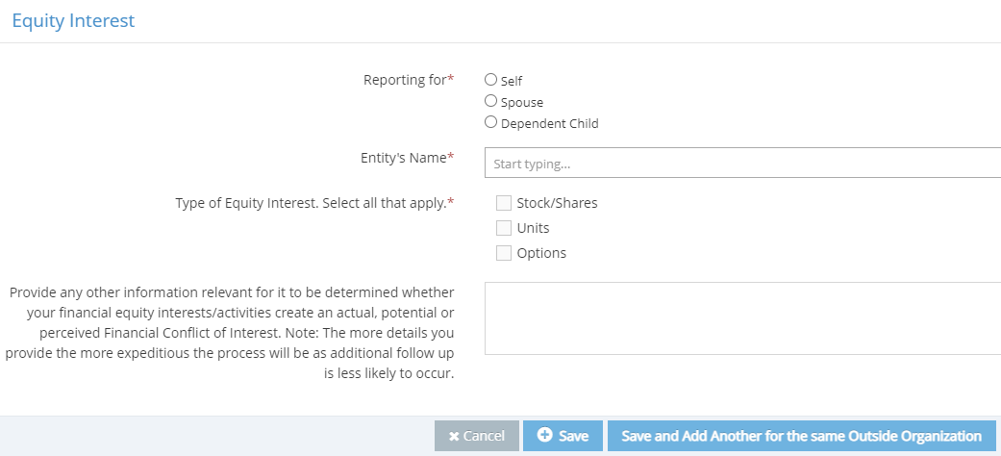
Disclose IP, Travel, and add any additional details in a text field as applicable

Slide 16
Outside interests will only need to be disclosed ONCE.
RI will approve the submission after all information is complete and thorough
Changes can be made to previously disclosed interests and new interests may be added at any time

Slide 17
“Project-Specific Disclosure” or “Relatedness”

Slide 18
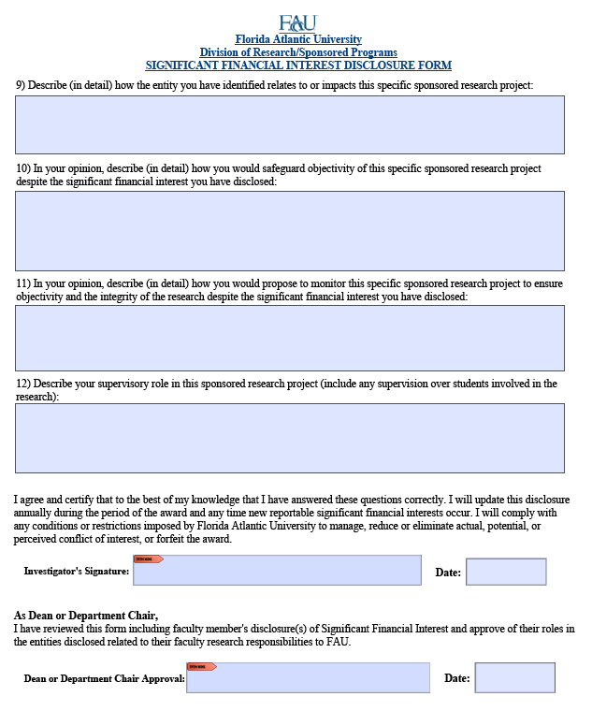
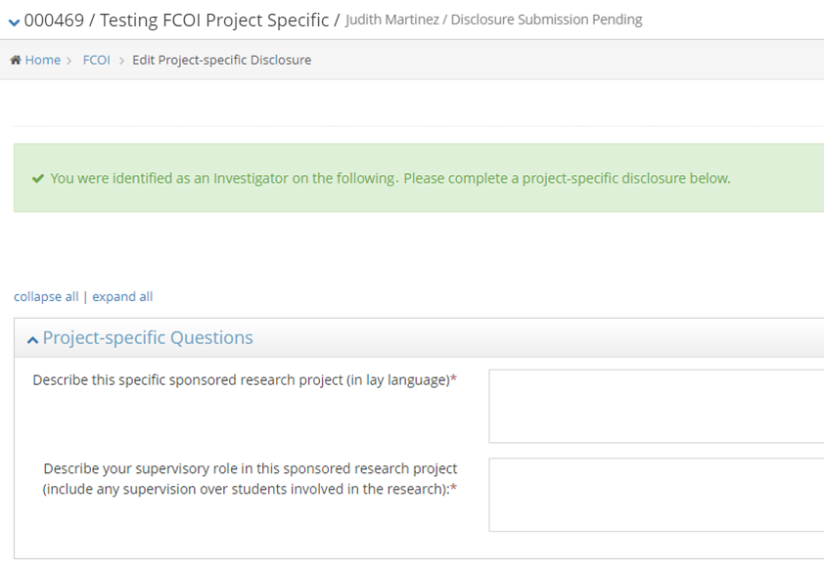
This section in Novelution replaces Section II, questions 9-12 on the paper form

Slide 19
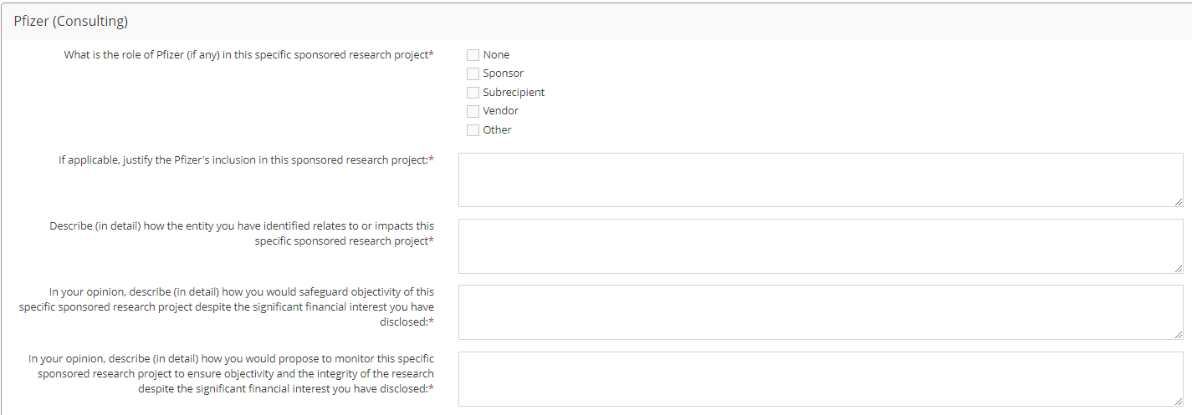
After answering the two general project-specific questions from the previous slide, researchers will have a panel for each entity that has been disclosed and will be asked to describe how the outside interest does or does not relate to the present project.

Slide 20
Project-Specific Disclosures will be required for each new project ONCE.
Annual updates: 60-days prior to the annual update due date, researchers will receive a notification to confirm if no changes were made or to make changes as needed
The form does not need to be re-completed from scratch

Slide 21
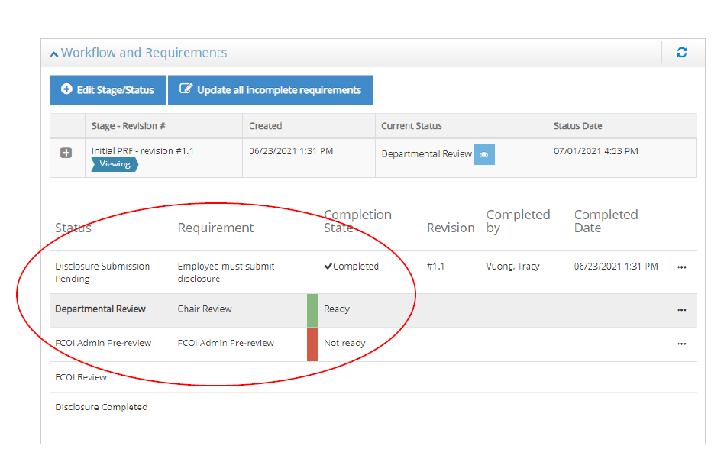
Project-Specific Disclosures
Project-Specific Disclosures
Are only required if, there was a SFI disclosure and the project has been awarded
Novelution will auto-generate notification(s) and task(s) for the investigator to complete the project-specific disclosure
Review, management, and approval from the department Chair, FCOI Committee, or others will be seamless and transparent through the workflow history

Slide 22
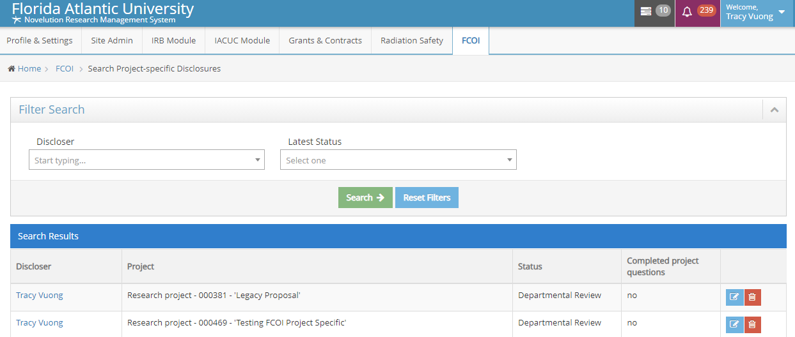
Users are in Control of their own Disclosure
Managing and Tracking Disclosures
Users can manage or review past disclosures
All submitted disclosures remain in the user’s FCOI module profile
Users can search past disclosures including project-specific disclosures
Approval documents or management plans will also be uploaded in the users’ FCOI module profile

Slide 23
September 1, 2021
Official Launch Date
Novelution submission will be required at this point
Paper disclosure will no longer be accepted for new submissions

Slide 24
FCOI Novelution Module Training Dates
Friday, August 6th at 3:00pm
Thursday, August 19th at 3:00pm
Wednesday, September 1st at 3:00pm

Slide 25
Contact Judith Martinez at martinezj2012@fau.edu or at researchintegrity@fau.edu for questions or comments

Slide 26
Final Thoughts and Questions
Final Thoughts and Questions
The Novelution FCOI module is a robust financial conflict of interest management and tracking tool
The FCOI module leverages the Sponsored Research module which makes the submission and tracking of disclosures seamless within one system
Users can view and update disclosures at anytime which gives them more control over their disclosures
In system notifications makes sure the user is always in compliance and reduces additional burden

